Slide 1
Carnegie Mellon University
Unified Purposes

Slide 2
Brandeis Projects Using Purposes
Four different Brandeis projects using purposes:
PrivacyStreams
Needed to declare purposes for private data queries
Policy Manager
Needed a store of purposes to pair with sensitive data requests so users can make informed policy decisions
App Policy Document
Needed to define purposes for data accesses occurring on the device
MobiPurpose
Monitored network traffic on mobile apps to determine the purpose of data access

Slide 3
Purpose Unification: The Process
List out all purposes across all projects
Eliminate duplicates
Remove any that were too vague, or possibly covered too few cases
Example: no clear distinction between "Social Networking Services" and "Social Media" in the policy manager purposes
Examine table 12 in MobiPurpose, and map each purpose into a general set of categories
Only purposes in table 12 were examined, because PE Android does not transfer control to the policy manager for data types such as device info.

Slide 4
Purpose Unification: The Process
MobiPurpose paper made an attempt at general categories
"We started with independent purpose categories … This structure is intuitive for both developers and users since apps are organized through these categories in the App Stores. ..."
Investigated app categories on the Google Play store
Many more app categories than purpose categories
Many app categories don't fit any purposes in any Brandeis Project (dating, finance, sports)
List of purposes that were unified can be found in Purposes1.3 document.

Slide 5
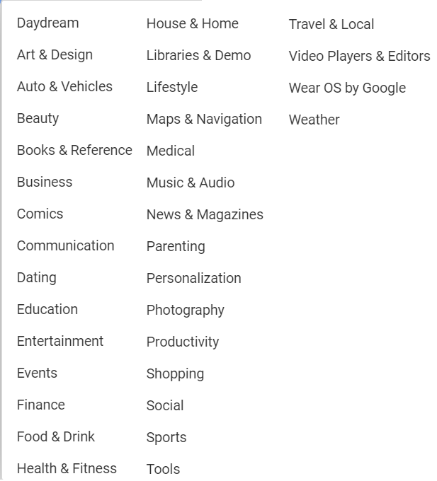
Google Play Store App Categories

Slide 6
Purpose Unification: Evaluation – Round One
New purposes were introduced, and purposes from MobiPurpose were eliminated or generalized.
Need to ensure the new set of purposes are still useful and meaningful.
To evaluate:
Brandeis Mobile CRT: document was shared among members and asked for feedback.
Internally at CMU: some apps were downloaded and asked to map the new purposes to functionality in the apps.
User studies: undergraduate researchers conducted an MTurk study, which asked participants if they understood the meaning of some purposes.

Slide 7
Purpose Unification: Evaluation – Round One Results
Results were mostly positive, but there could be a little bit of confusion over the "app utility" purpose.
There is a possibility that users may prefer to have the more detailed purposes provided in MobiPurpose.
No studies were conducted on how much privacy is really lost when comparing the more detailed purposes vs the general categories.

Slide 8
Purpose Unification Evaluation – Round Two
Master's in Human-Computer Interaction students began to use unified purposes in user studies for the policy manager.
Purposes were included on cards for policy controls:
Participants were sometimes asked what they thought purposes meant.
Participants were given policy manager-related tasks to complete, and evaluated the difficulty of the task.
Some participants were struggling with understanding some purposes, such as "Geotagging".
Determined purposes need another round of iteration.

Slide 9
Purpose Clarification
With a group of four students:
Go through each purpose one-by-one.
Ask each student if they understood what a purpose meant, and if they think they understand, what does it mean?
Some purposes were understood. Some students believed they understood what some purposes meant, but didn't.
Purposes were re-worked to be short, meaningful and most importantly, included some kind of action word.
Ex: Delivering Advertisements, Playing Games etc.
Some purposes were also determined as being un-necessary or redundant such as "Development" or "Voice and Speech Recognition".
See "CMU Final Purposes" document for list of purposes.

